Slide 1

Tutorial Questions （Week 10）
Haohao Li (李好好)
Southern University of Science and Technology
Email: 12432581@mail.sustech.edu.cn

Slide 2
Review
Basic system properties
Causality, Linearity, Time-invariance, Stability
Fourier transform integral algorithm
Convolution algorithm(principle)
Frequency shift properties of the Fourier transform
Dirichlet conditions
discrete-time periodic signal
Period value, Fourier series coefficients
Block Diagram Representations of First-Order Systems Described by Differential and Difference Equations

Slide 3
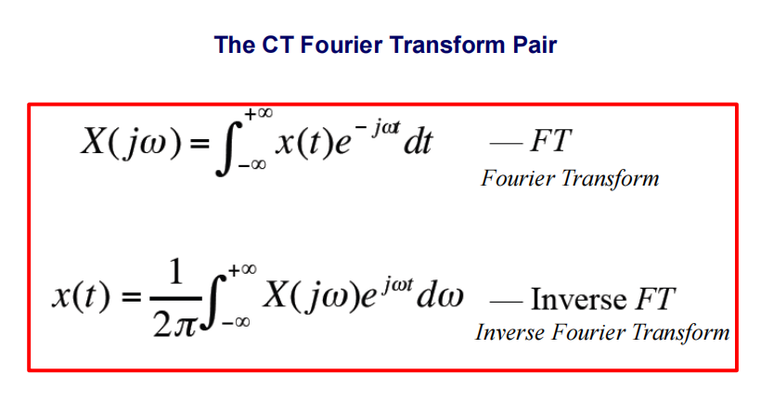

Fourier transform integral algorithm
frequency response H(ω) of an LTI system：

Slide 4

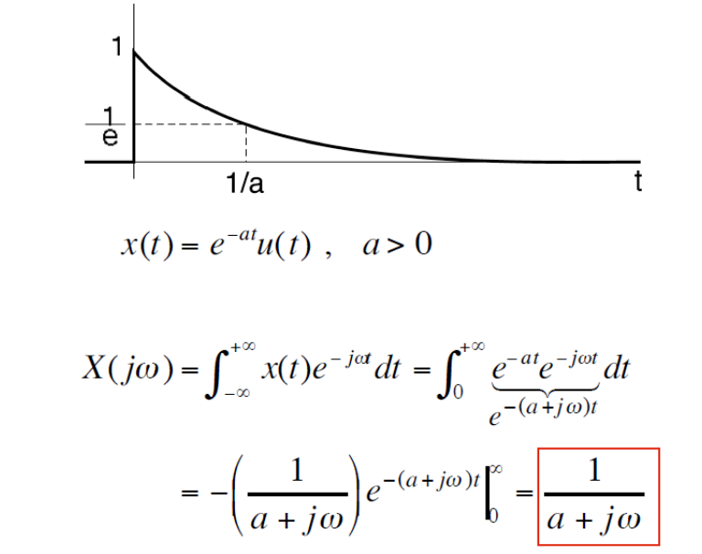
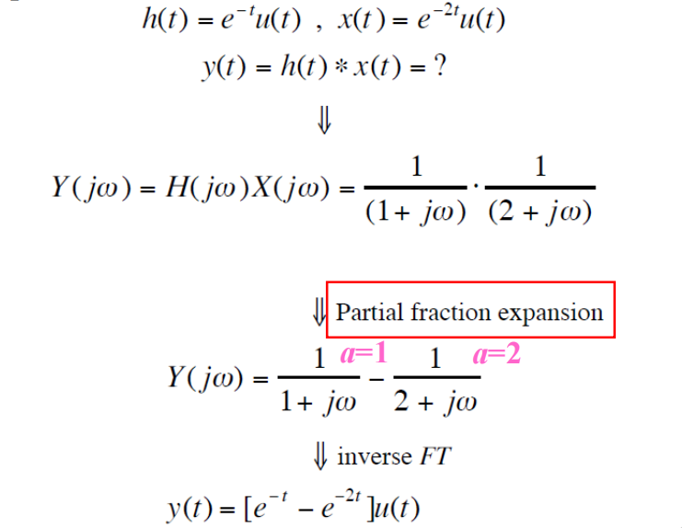
Convolution algorithm(principle)
Fourier transform ：
Convolution ：

Slide 5
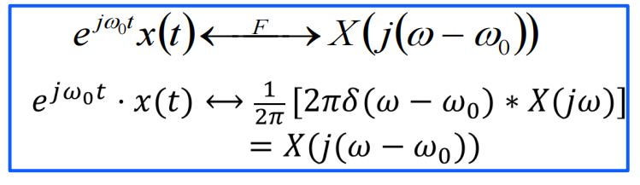
Frequency shift properties of the Fourier transform
Frequency shift：
Dirichlet conditions
The signal must be continuous or have only a finite number of first-class discontinuities in a cycle.
The number of maxima and minimum should be limited in a week
During the week, the signal is absolutely accumulative

Slide 6
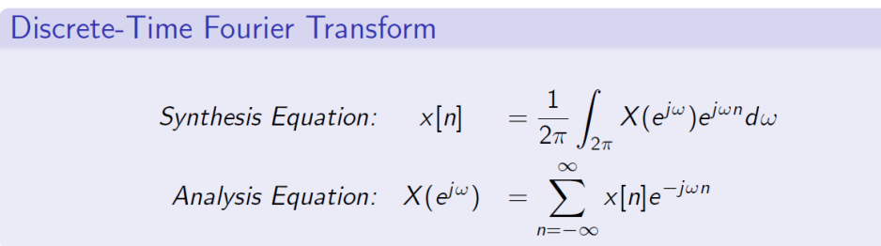
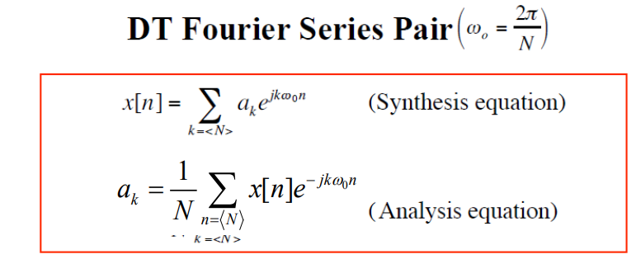
discrete-time periodic signal

Slide 7
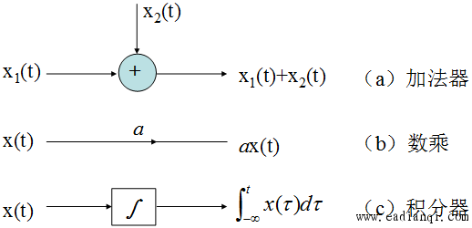
Block Diagram Representations of First-Order Systems Described by Differential and Difference Equations

Slide 8
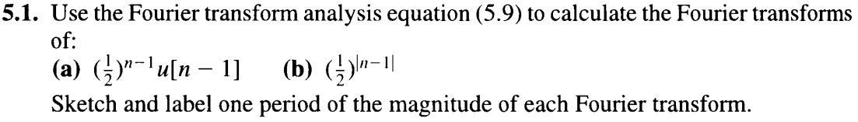
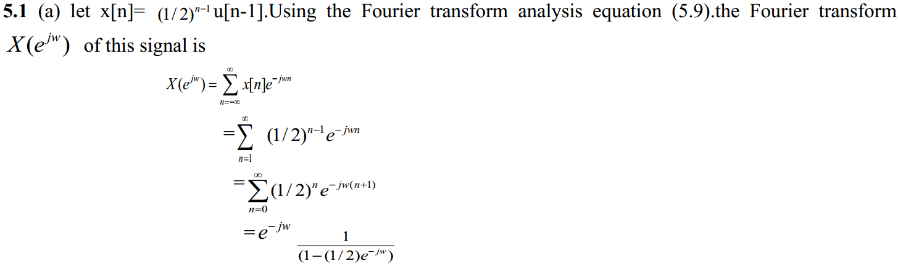
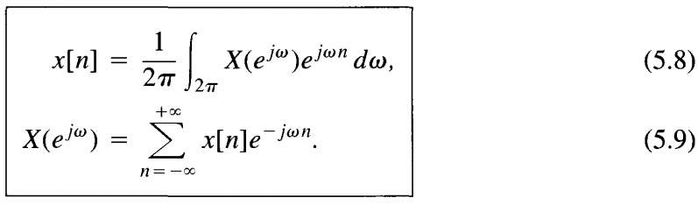
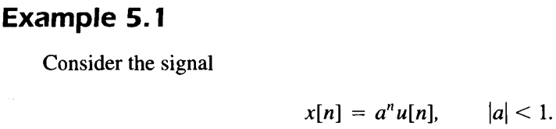
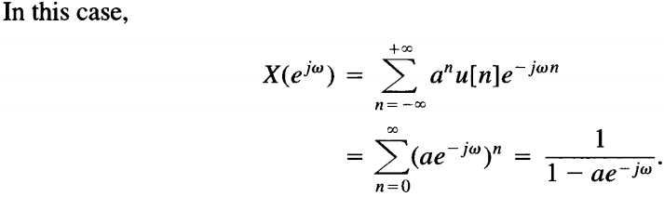
discrete-time Fourier transform pair

Slide 9


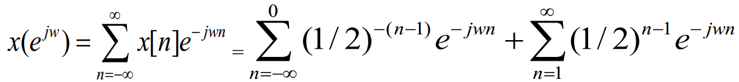
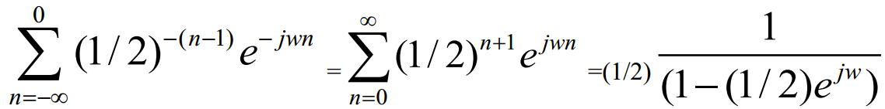

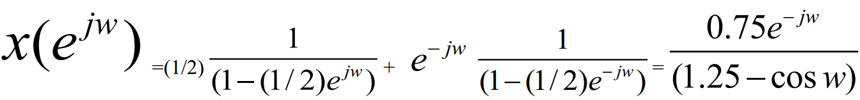

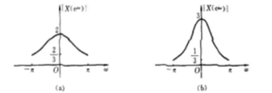

Slide 10
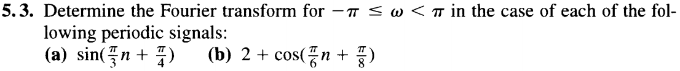
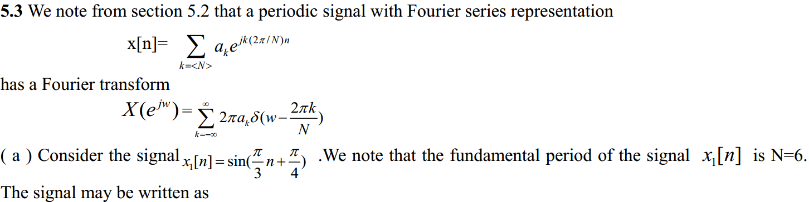


K=1
K= -1

Slide 11
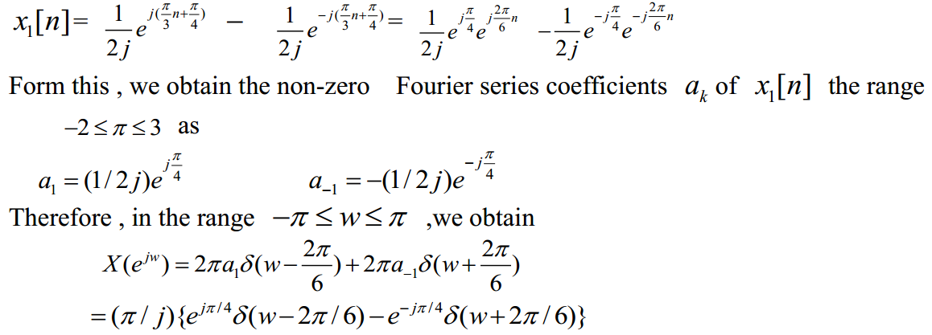
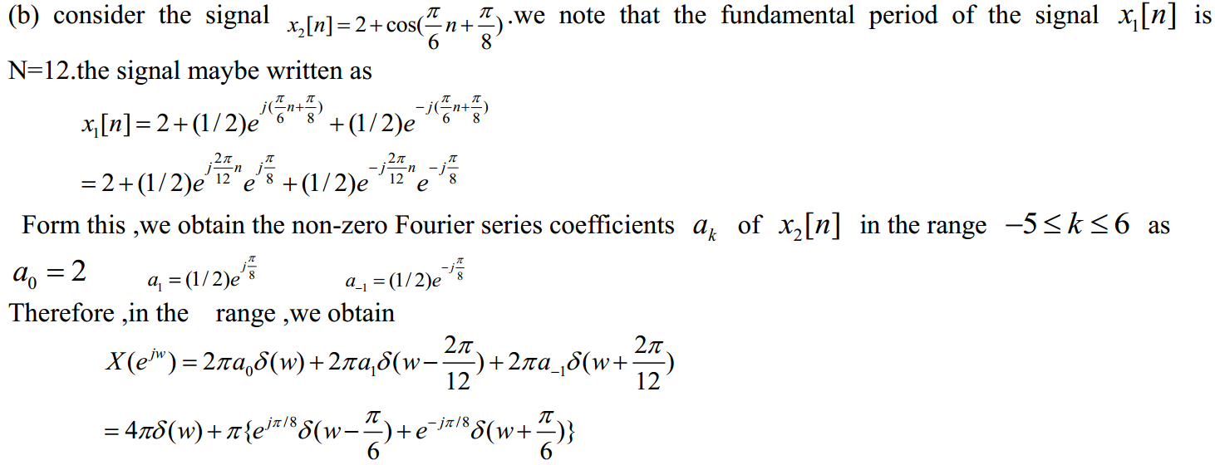


Slide 12
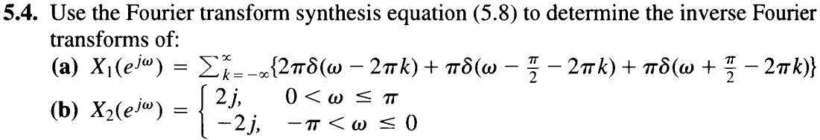
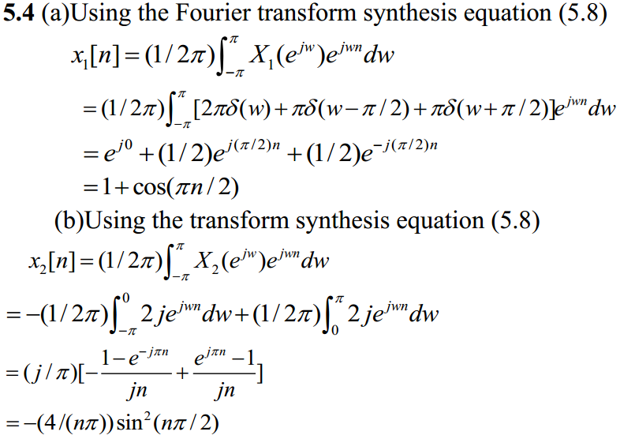
discrete-time Fourier transform pair
Only one period

Slide 13
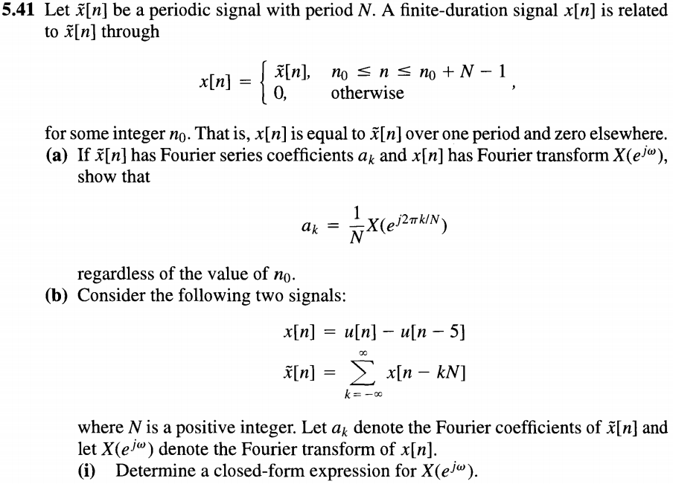
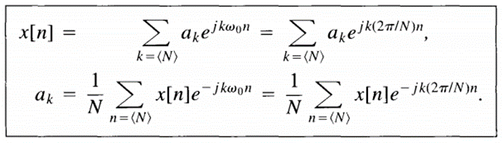
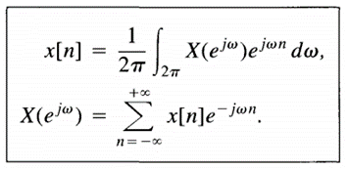

Slide 14
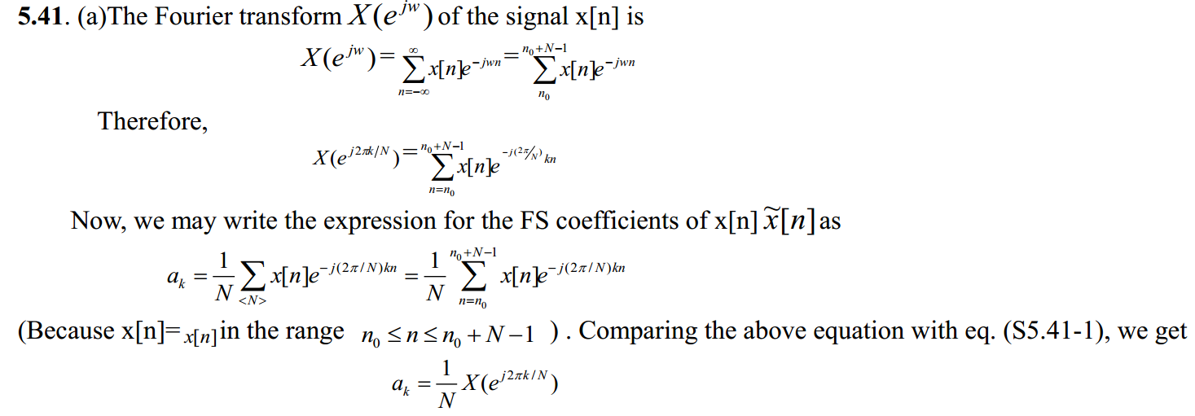




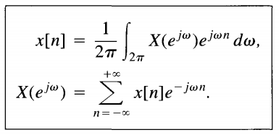
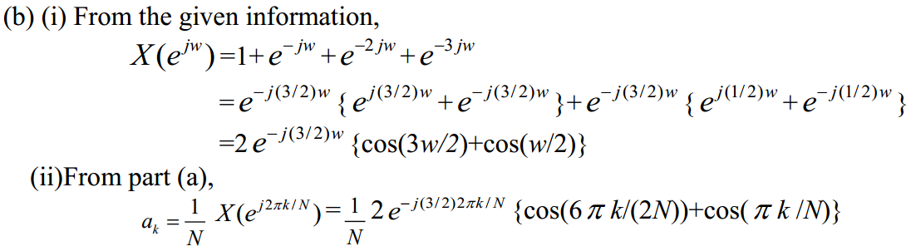
S5.41-1

